Slide 1
Intro to jQuery
WEBD 113 - Motion Graphics
Link to slides: http://bit.ly/humber-motion-7
Ryan Christiani
Week 7

Slide 2
Assignment Review
Use of Prefixes
Repetition.

Slide 3
What is Javascript
Javascript is the brains of your website.
It handles the complex interactions and logic that you can not handle with CSS.
It was created in 10 days, today it is one of the most used languages in the world.
Javascript is NOT Java, Java is another programing language altogether.

Slide 4
What is jQuery
jQuery is a Javascript library that was developed to help make long tasks in “vanilla” Javascript, simple and easy to do.
It takes care of all the browser differences that you would have to be mindful of.
It is awesome.

Slide 5
Why use jQuery
Lets look at an example. In javascript, in order to get a reference to an element that has an id of box-container, you would have to write this.
var boxEl = document.getElementById(‘box-container’);
jQuery example:
var boxEl = $(‘#box-container’);

Slide 6
Interactions built with Javascript
http://www.gonzaloperez.ws/
http://studioaka.co.uk/
http://app360.quixey.com/

Slide 7
Adding jQuery to your page
There are 2 ways to add jQuery to your page. One involves downloading the file and linking it in your document. The second involves linking the files from a CDN(content delivery network).
1: Go to http://jquery.com/ and click “Download”. Select the version you want. Pick one that says “production”
2: Go to the same page but a different section HERE and follow the instructions there.

Slide 8
Differences in loading jQuery.
If you download and link the file you have what is considered to be a local copy of jQuery. Good for when you need to develop offline
When you use a CDN you do not have access to that files on your computer. But you have the benefit of this file being cached* on the users computer. Bad for when you need to develop offline.
*file has already been downloaded once before and does not need to be downloaded again.

Slide 9
Adding jQuery to your page cont.
…
<script src=”path/to/jquery.js”></script>
<script src=”path/to/yourfile.js”></script>
</body>
</html>
Load your js at the end of your page so that it does not block the page from loading. This helps speed up the page in terms of what people can see before interactions take place.

Slide 10
Using jQuery
jQuery is very easy to use. We call jQuery with this syntax $() the important thing here being the $ sign. This is the variable that jQuery is aliased too. Inside the parentheses we can use our familiar CSS selectors to get references to our HTML elements.
$(‘.box’).height(‘500px’);
//Will get .box elements and set the height to be 500px.
//Alternative
jQuery(‘.box’)......

Slide 11
Lets try this out.
Open up Chrome and lets go to http://www.gonzaloperez.ws/
Open up the developer tools. You can do it by hitting cmd(ctrl) + option(alt) + j, or right clicking on the page and selecting inspect element.
Lets take a minute to go through the developer tools.
The developer tools let you interact with sites, and play around with the code. You can debug your of html, css or javascript from here. You can test something, play with values and then when you know what you want go back to your code and make the change.

Slide 12
jQuery Plugins
One of the greatest things about web development is that if you need to perform certain task, odds are someone has created a jQuery Plugin for that.
What is a jQuery Plugin?
A jQuery plugin is simply a new method that we use to extend jQuery'sprototype object. By extending the prototype object you enable alljQuery objects to inherit any methods that you add. As established, whenever you call jQuery() you're creating a new jQuery object, with all of jQuery's methods inherited

Slide 13
Common jQuery Plugins
Image Sliders, drop down menus, date pickers, colour pickers, calendars, light boxes, images galleries, accordion menus, tooltips, animations, tweening, auto scrolling, parallax, forms, custom input fields, etc…
A jQuery plugin will help you save time by doing a lot of the heavy lifting for you. Example being an image slider, everyone has tried to write one of these, but odds are there is a plugin out there that fits your needs.

Slide 14
Lets play with jQuery
Lets play around with getting familiar with jQuery. We won’t go too indepth today, but lets get our hands a little dirty.
Lets start a new file and go through the process of adding jQuery and adding our own Javascript file.

Slide 15
Common jQuery Methods
There are something like 300+ jQuery Methods, but lets look at a few of them right now.
.hide();
.show();
.addClass();
.removeClass();
.slideUp();
.slideDown();
.css();

Slide 16
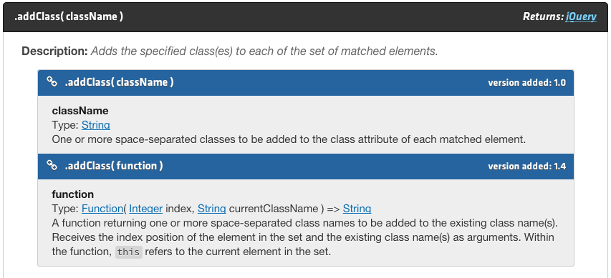
jQuery Documentation
All of these methods are show up on http://api.jquery.com/. Reading the documentation is fairly straightforward.

Slide 17
$(document).ready()...
One thing you have to keep in mind when using javascript and working with the DOM(HTML) is that the HTML needs to be loaded before we start manipulating it.
jQuery offers a way to check to make sure that the document is ready before we start interacting with it.
$(document).ready(function() {
//Your code in here.
});

Slide 18
$(document).ready()...
We can test to see if this works by adding this line
$(document).ready(function() {
console.log(‘Testing’);
});
console.log(); logs a message to the console(in the dev tools). This is great for debugging.

Slide 19
jQuery Events
The great thing about Javascript is that we can hook into browser events. Stuff like click, mouseover(hover), scroll, resize, etc…
In this case we will just look at the click event. We can add an event in jQuery using the .on() method.
$(‘.box’).on(‘click’,function() {
… //Do something!
});

Slide 20
Lets play with events.
Lets add an event to our page. We will use .on() and .toggleClass() to toggle a class on an element.
The idea will be that we can click on 1 HTML element and toggle a class on another HTML element to do something, the something will be some CSS animations we are familiar with.

Slide 21
Next Week.
I will be away next week.
I would like you to take everything you know and play around. There is so much that can be done with what you know. Come up with a crazy idea and just go to town.
Also take the time to do the first two courses in the jQuery Basics on Treehouse http://teamtreehouse.com/library/jquery-basics

